Slide 1
Azure Devops

Slide 2





Introducing Azure DevOps
Azure Boards
Azure Pipelines
Azure Repos
Build, test, and deploy with CI/CD that works with any language, platform, and cloud. Connect to GitHub or any other Git provider and deploy continuously.
Get unlimited, cloud-hosted private Git repos and collaborate to build better code with pull requests and advanced file management.
Deliver value to your users faster using proven agile tools to plan, track, and discuss work across your teams.
Azure Test Plans
Azure Artifacts
Test and ship with confidence using manual and exploratory testing tools.
Create, host, and share packages with your team, and add artifacts to your CI/CD pipelines with a single click.
➔
https://azure.com/devops

Slide 3


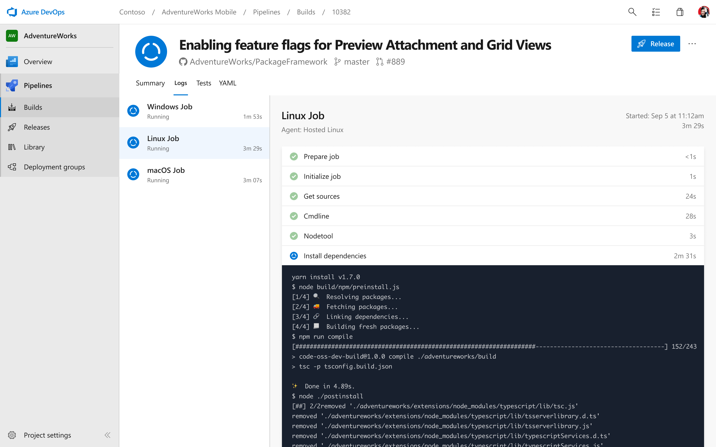

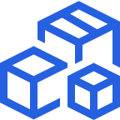
Azure Pipelines
Cloud-hosted pipelines for Linux, Windows and macOS.
Any language, any platform, any cloud
Build, test, and deploy Node.js, Python, Java, PHP, Ruby, C/C++, .NET, Android, and iOS apps. Run in parallel on Linux, macOS, and Windows. Deploy to Azure, AWS, GCP or on-premises
Extensible
Explore and implement a wide range of community-built build, test, and deployment tasks, along with hundreds of extensions from Slack to SonarCloud. Support for YAML, reporting and more
Containers and Kubernetes
Easily build and push images to container registries like Docker Hub and Azure Container Registry. Deploy containers to individual hosts or Kubernetes.
https://azure.com/pipelines
➔

Slide 4


Azure Pipelines
Microsoft Open Source
Free unlimited build minutes for public projects
Up to 10 free parallel jobs across Windows, Linux and macOS
➔
https://azure.com/pipelines

Slide 5

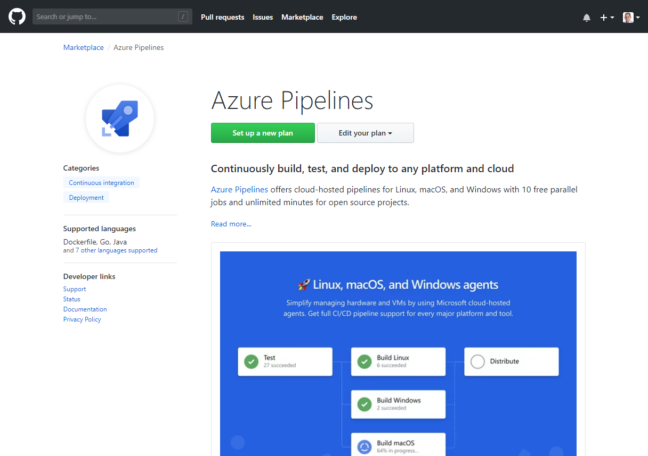
Integrated with GitHub
Azure Pipelines available now to any developer from the GitHub Marketplace

Slide 6
DevOps basics
2) Code Repository
3) Build
4) Test
5) Deploy to Cloud
Contoso App
1) Developers
Azure
6) Monitor and Improve

Slide 7


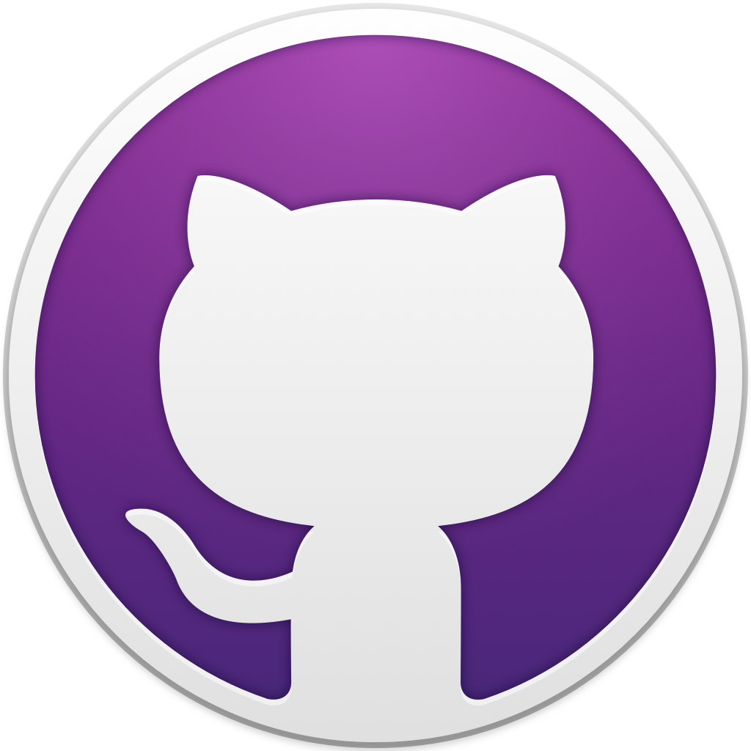
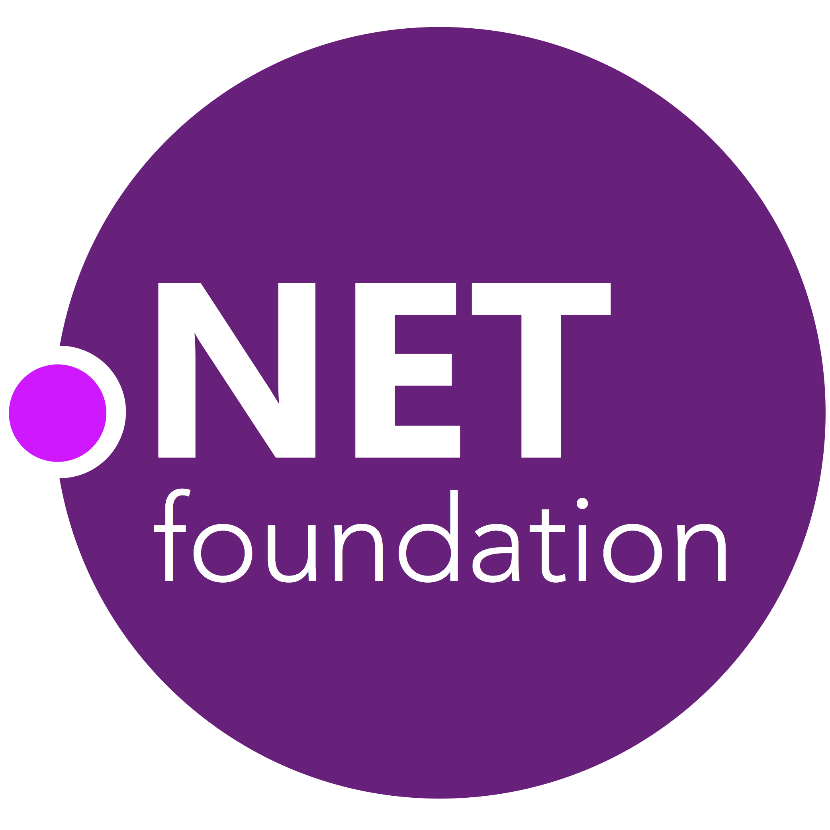
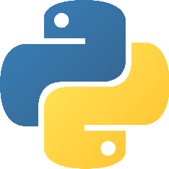

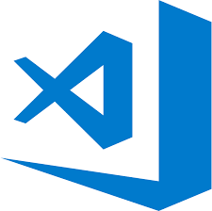
Early adopters
Open source projects already powered by Azure Pipelines

Slide 8
Azure DevOps
Better together
Azure Boards
Azure Repos
Azure Pipelines
Azure Test Plans
Azure Artifacts
An end-to-end solution for organizations looking for an enterprise-grade toolchain
Fully Integrated with end to end traceability
Scalable to any team and project size
Highly available, multi region, hybrid cloud & on-prem
Customer Support
Consistent admin and access control
➔
https://azure.com/devops

Slide 9



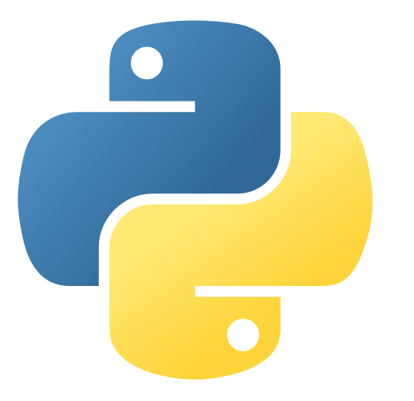
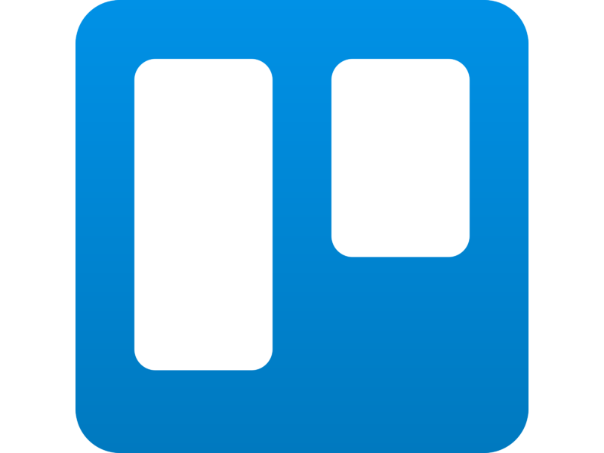
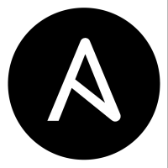

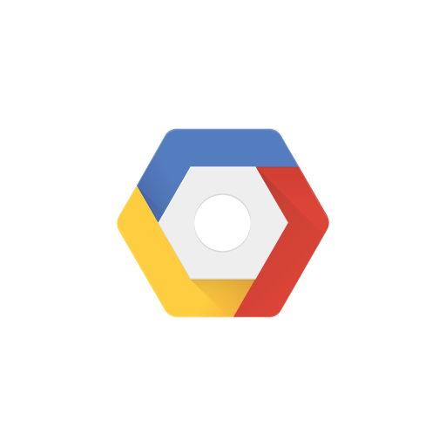

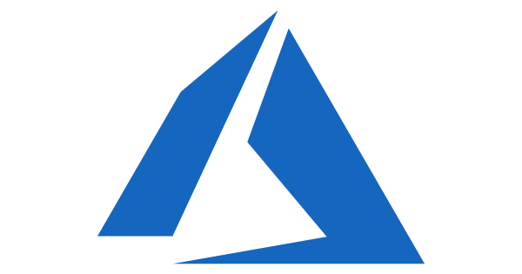

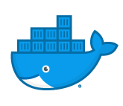
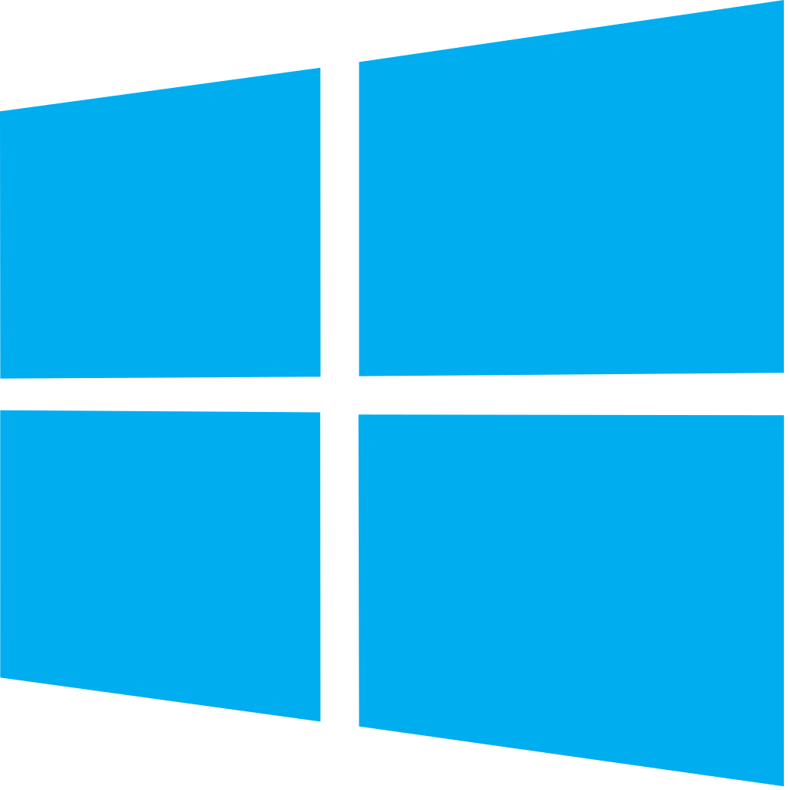


Azure DevOps: Choose what you love
Your tools, languages, and clouds
Azure DevOps lets developers choose the tools and languages that are right for them
Mix and match to create workflows with tools from Microsoft, open source or your favorite 3rd party tools
Target any cloud, on-prem or both and deploy to the servers you need

Slide 10

Azure Pipelines
Cloud-hosted pipelines for Linux, Windows and macOS, with unlimited minutes for open source
Any language, any platform, any cloud
Build, test, and deploy Node.js, Python, Java, PHP, Ruby, C/C++, .NET, Android, and iOS apps. Run in parallel on Linux, macOS, and Windows. Deploy to Azure, AWS, GCP or on-premises
Extensible
Explore and implement a wide range of community-built build, test, and deployment tasks, along with hundreds of extensions from Slack to SonarCloud. Support for YAML, reporting and more
Containers and Kubernetes
Easily build and push images to container registries like Docker Hub and Azure Container Registry. Deploy containers to individual hosts or Kubernetes.
Best-in-class for open source
Ensure fast continuous integration/continuous delivery (CI/CD) pipelines for every open source project. Get unlimited build minutes for all open source projects with up to 10 free parallel jobs across Linux, macOS and Windows
➔
https://azure.com/pipelines

Slide 11





Azure DevOps
Plan smarter, collaborate better, and ship faster with a set of modern dev services
Any developer, any platform, any cloud. Full support for hybrid cloud, on-premises & containers.
Use all the Azure DevOps services or choose just what you need to complement your existing workflows
Best in class builds for open source. Free unlimited build minutes for public projects and up to 10 free concurrent jobs across Windows, Linux and macOS
Get started for free for small teams, scales to support the largest enterprises
Azure Boards
Azure Repos
Azure Pipelines
Azure Test Plans
Azure Artifacts
➔
https://azure.com/devops
Start free today

